Slide 1
03.
Operators in Python
^
||
~
>>

Slide 2
Operators
(=)
wHat are operators?
and, or
A symbol used to perform mathematical and logical operations in a program.
Operator is a special symbol that tells to the compiler to perform mathematical or logical operations.
>=
**=
||
<<

Slide 3
Types of Operators
Relational Operators
Bitwise Operators
Membership Operators
Arithmetic Operators
Assignment Operators
Logical Operators
Identity Operators

Slide 4

Arithmetic Operators
wHat are arithmetic Operators?
An arithmetic operator is a mathematical function that takes two operands and performs a calculation on them.
Example : 2+5=7

Slide 5
Arithmetic Operators
a = 10, b = 5 are operands in this case
Operator | Meaning | Variable Example | Numerical Example
+ | Add two operands or unary plus | c = a+b | 10 + 5 = 15
- | Subtract right operand from the left or unary minus | c = a-b | 10 - 5 = 5
* | Multiply two operands | c = a*b | 10 * 5= 50
/ | Divide left operand by the right one (always results into float) | c = a/b | 10 / 5 = 2

Slide 6
Arithmetic Operators
a = 10, b = 5 are operands in this case
Operator | Meaning | Variable Example | Numerical Example
% | Modulus - remainder of the division of left operand by the right | c = a%b | 10 % 5 = 0
// | Floor division - division that results into whole number adjusted to the left in the number line | x // y | 10 // 5 = 2
** | Exponent - left operand raised to the power of right | x**y | 10 **5 = 100000

Slide 7
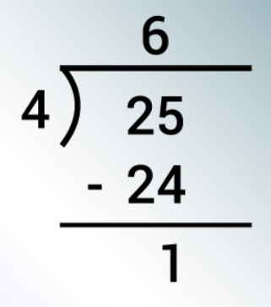
Arithmetic Operators
Difference between / and % operators
The division operator (/) computes the quotient (both for float and integer variables).
The modulus operator (%) computes the remainder when one integer is divided by another.
In Python, modulus operator supports both integer and float type variables.
Quotient
Remainder

Slide 8
Arithmetic Operators
Difference Between Modulus (%) & Floor Division (//)
Floor Division:
13 // 4 = 3
Modulus Operation: 13 % 4 = 1
4 occurs three times in 13.
If you divide 13 by 4 you will get 1 as remainder.
//
%

Slide 9
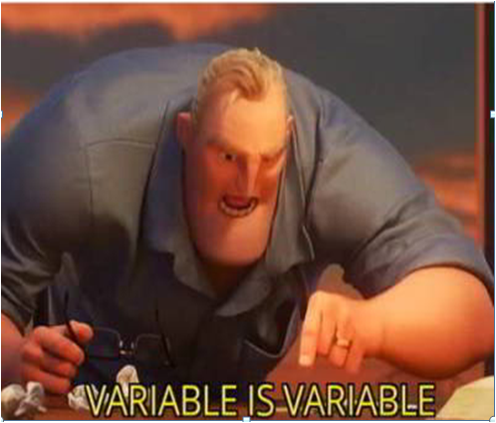
Division Operator for mixed data type
Numerical example
Variables with Float and Integer Data Type
a=5.0
b=2.0
c=5
d=2
Python works well with mixed data types!!!
a/b = 2.5
a/d = 2.5
c/b = 2.5
c/d = 2.5

Slide 10
Lms activity

Slide 11

Assignment Operators
What are assignment operators?
The assignment operators are used to assign the right hand side value (Rvalue) to the left hand side variable (Lvalue).
The assignment operator is used in different variations along with arithmetic operators.

Slide 12
Assignment Operators
Part-1
Operator | Meaning | Numerical Example
= | Assign the right hand side value to left hand side variable. | A = 15
+= | Add both left and right hand side values and store the result into left hand side variable. | A += 10 ⇒ A=A+10
-= | Subtract right hand side value from left hand side variable value and store the result into left hand side variable. | A -= B ⇒ A=A-B
*= | Multiply right hand side value with left hand side variable value and store the result into left hand side variable. | A *= B ⇒ A=A*B

Slide 13
Assignment Operators
Part-2
Operator | Meaning | Numerical Example
/= | Divide left hand side variable value with right hand side variable value and store the result into left hand side variable. | A /= B ⇒ A=A/B
%= | Divide left hand side variable value with right hand side variable value and store the remainder into left hand side variable. | A %= B ⇒ A=A%B
//= | Floor Division: Divide left operand with right operand and then assign the value(floor) to left operand. | A// = 5
**= | Exponent - left operand raised to the power of right | A **= 5 ⇒ A=A**5

Slide 14
Assignment Operators
Part-3
Operator | Meaning | Numerical Example
&= | The result of Bitwise AND is 1 if all the bits are 1 otherwise it is 0. | A &= B ⇒ A=A&B
|= | The result of Bitwise OR is 0 if all the bits are 0 otherwise it is 1 | A |= B ⇒ A=A|B
^= | The result of Bitwise XOR is 0 if all the bits are same otherwise it is 1. | A ^= B ⇒ A=A^B
>>= | The Bitwise left shift operator shifts all the bits to the left by specified number of positions | A >>= B ⇒ A=A>>B
<<= | The Bitwise right shift operator shifts all the bits to the right by specified number of positions | A <<= B ⇒ A=A<<B

Slide 15
Lms activity

Slide 16
Relational or comparison Operators
(>)
(<=)
(=)
Less than
Greater than
Or equal to
Not equal to
1
2
3
4
5
6
Greater
than
Less than
Or equal to
Equal to
(<)
(>=)
(!=)

Slide 17
Relational or comparison Operators
What are relational operators?
Relational operators are used to compare two values.
They are used to check the relationship between two values.
Every relational operator has two results TRUE or FALSE.
Example : Your marks are greater Sam’s
9>6

Slide 18
Relational or comparison Operators
Part-1
Operator | Meaning | Numerical Example
> | Less than - True if left operand is less than the right or else False. | A > B
< | Greater than - True if left operand is greater than the right or else False. | A < B
<= | Less than or equal to - True if left operand is less than or equal to the right or else False. | A <= B

Slide 19
Relational or comparison Operators
Part-2
Operator | Meaning | Numerical Example
>= | Greater than or equal to - True if left operand is greater than or equal to the right or else False. | A >= B
== | Equal to - True if both operands are equal or else False. | A == B
!= | Not equal to - True if operands are not equal or else False. | A != B

Slide 20
Lms activity

Slide 21

Logical Operators
What are logical operators?
Logical operators are used on conditional statements (either True or False).
The logical operators are the symbols that are used to combine multiple conditions or expressions into single condition.

Slide 22

Logical Operators
logical And
Logical AND - Returns TRUE if all conditions are TRUE otherwise returns FALSE.
Example
(10 < 5 and 12 > 10)
False and True
is FALSE

Slide 23

Logical Operators
logical or
Logical OR - Returns FALSE if all conditions are FALSE otherwise returns TRUE.
Example
(10 < 5 or 12 > 10)
False or True
is TRUE

Slide 24

Logical Operators
logical not
Logical NOT - Returns TRUE if condition is FALSE and returns FALSE if it is TRUE
Example
not(10 < 5 and 12 > 10)
is TRUE

Slide 25
Lms activity

Slide 26

membership Operators
What are membership operators?
The membership operators in Python are used to test whether a value is found within a sequence.
Example :
‘Hello’ in ‘Hello World’

Slide 27

Membership Operators
in
True if value/variable is found in the sequence.
Example
x = [1, 2, 3, 4, 5, 6]
print(5 in x)
Output: True

Slide 28

Membership Operators
Not in
True if value/variable is not found in the sequence.
Example
x = [1, 2, 3, 4, 5, 6]
print(5 not in x)
Output: False

Slide 29
Membership Operators
examples
a = “Welcome to Python”
print("Greetings" not in a)
Output: True
print("Greetings" in a)
Output: True

Slide 30
Lms activity

Slide 31

identity Operators
What are identity operators?
Identity operators are used to determine whether a value is of a certain class or type. They are usually used to determine the type of data a certain variable contains.
There are two types of identity operators.
is - will return output as True if the operands are identical or refer to the same object.
Such as x is true.
is not - will return output as True if the operands are not identical or do not refer to the same object.

Slide 32

identity Operators
is
True if the operands are identical (refer to the same object).
Example
x = [1, 2, 3, 4, 5, 6]
print(x is x)
Output: True

Slide 33

identity Operators
Is not
True if the operands are not identical (do not refer to the same object)
Example
x = [1, 2, 3, 4, 5, 6]
print(x is not x)
Output: False

Slide 34

Type function
What is type function?
The type() function returns the type of the specified object.
Python is truly object oriented language, where every variable is an object, and every piece of code is a method.

Slide 35
Type function
examples
#Assign the values to a, b, c, d objects
a = 10
b = "Hello World"
c = 33.33
d= 2+3j
The Output:
<class 'int'>
<class 'str'>
<class 'float'>
<class 'complex'>
#use type() function to understand the type of #the data stored in the variable or referred by #the object
print(type(a))
print(type(b))
print(type(c))
print(type(d))

Slide 36
Identity Operators
examples
# Python program to illustrate the use
# of 'is' identity operator
x = 5
if (type(x) is int):
print("true")
else:
print("false")
# Python program to illustrate the
# use of 'is not' identity operator
x = 51.2
if (type(x) is not int):
print("true")
else:
print("false")
Output - True

Slide 37
Lms activity

Slide 38

Bitwise Operators
wHat are bitwise operators?
The bitwise operators are used to perform bit level operations.
When we use bitwise operators, the operations are performed based on the binary values.

Slide 39
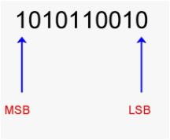
msb & lsb
wHat are MSB & LSB?
LSB: Least Significant Bit
MSB: Most Significant Bit
The Most Significant Bit (MSB) is the bit in a multiple-bit binary number with the largest value. This is usually the bit farthest to the left, or the bit transmitted first in a sequence.
The Least Significant Bit (LSB) is the bit in a binary number which is of the lowest numerical value.
In this example, MSB is 1 and LSB is 0.

Slide 40
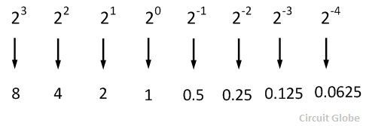
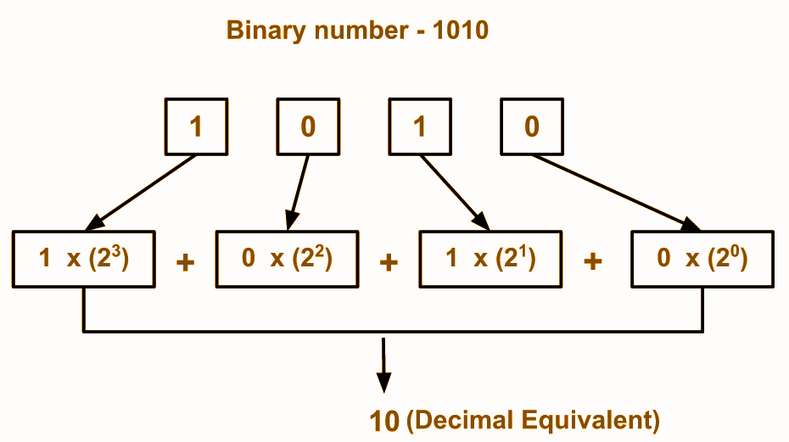
number conversion: binary to Decimal
How to convert binary to Decimal?
The base of the binary number system is 2, and it is increased by the factor of two. The first digit has 2⁰ weights, the second has 2¹ weights, the weight of the third digit is 2² and so on.
In binary to decimal conversion when there is one in a digit position of a binary number, then the weight of the position is added. But when there is the zero in a binary position the weight of the position is disregarded.

Slide 41
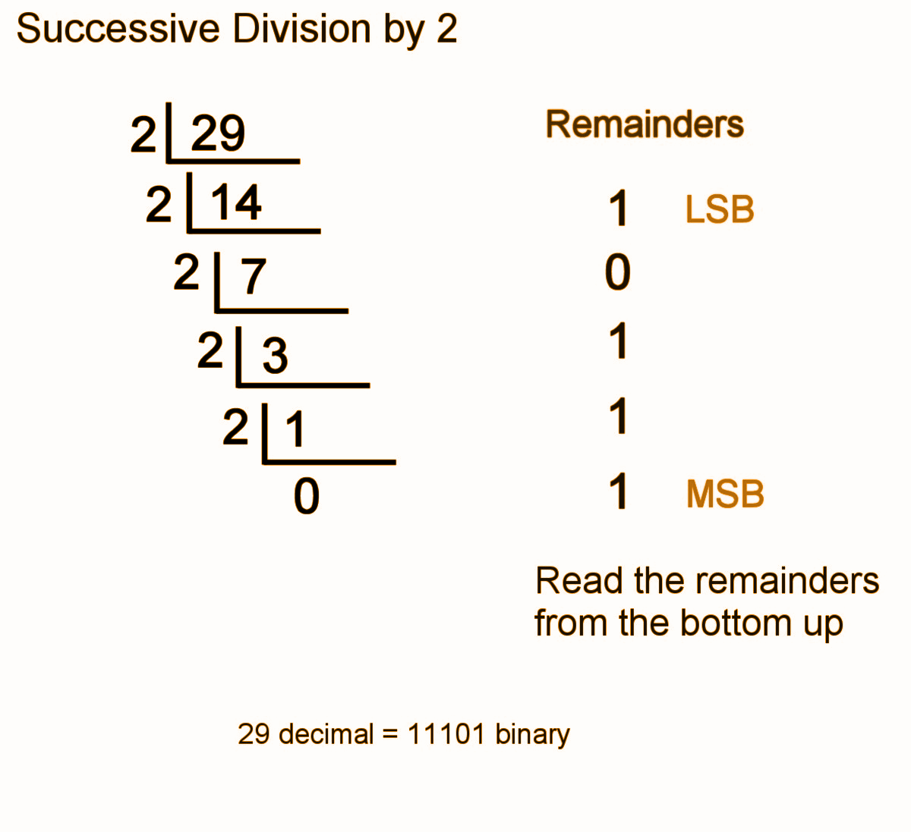
number conversion: Decimal to binary
How to convert Decimal to binary?
An easy method of converting decimal to binary number equivalents is to write down the decimal number and to continually divide-by-2 (two) to give a result and a remainder of either a “1” or a “0” until the final result equals zero.

Slide 42
Bitwise Operators
Variables: A = 25 (11001) and B = 20 (10100)
Operator | Meaning | Numerical Example
& | The result of Bitwise AND is 1 if all the bits are 1 otherwise it is 0. | A & B ⇒ 16 (10000)
| (Pipe) | The result of Bitwise OR is 0 if all the bits are 0 otherwise it is 1. | A | B ⇒ 29 (11101)
^ (Cap) | The result of Bitwise XOR is 0 if all the bits are same otherwise it is 1. | A ^ B ⇒ 13 (01101)
~ (Tilde) | The result of Bitwise Not 1’s complement is negation of the bit (Flipping). | ~A ⇒ 6 (00110)

Slide 43

bitwise Operators
Truth Table
AND (&)
OR (|)
XOR (^)
1
0
1
1
0
1
1
1
1
0
1
0
1
1
1
1
1
1
Input Output
1 & 1 = 1
1 & 0 = 0
0 & 1 = 0
0 & 0 = 0
Input Output
1 | 1 = 1
1 | 0 = 1
0 | 1 = 1
0 | 0 = 0
Input Output
1 ^ 1 = 0
1 ^ 0 = 1
0 ^ 1 = 1
0 ^ 0 = 0

Slide 44

bitwise Operators
Truth table
Not (~)
0
1
1
0
Input Output
0 = 1
1 = 0

Slide 45
Bitwise Operators
Variables: A = 25 (11001) and B = 20 (10100)
Operator | Meaning | Numerical Example
<< | The Bitwise left shift operator shifts all the bits to the left by specified number of positions. | A<<2 ⇒ 100 (1100100)
>> | The Bitwise right shift operator shifts all the bits to the right by specified number of positions. | A>>2 ⇒ 6 (00110)

Slide 46
bitwise Operators
Left Shift
Right Shift
Add
Delete
1
0
0
1
1
1
0
1
0
0
1
1
1
0
Shifts the bits of the number to the left and fills 0 on voids left as a result. Similar effect as of multiplying the number with some power of two.
Shifts the bits of the number to the right and fills 0 on voids left as a result. Similar effect as of dividing the number with some power of two.

Slide 47
Bitwise Operator
examples
Right Shift Operator >>
Left Shift Operator <<
Example 1:
a = 5 = 0000 0101
a << 1 = 0000 1010 = 10
a << 2 = 0001 0100 = 20
Example 1:
a = 10
a >> 1 = 5
Example 2:
b = -10 = 1111 0110
b << 1 = 0000 1010 = -20
b << 2 = 0001 0100 = -40
Example 2:
a = -10
a >> 1 = -5

Slide 48
Lms activity

